Slide 1
Minimally Invasive Annuloplasty
Technology for Tricuspid and Mitral
Valve Repair
Mathew Williams, MD
NYU Langone Medical Center
Thursday, May 23, 2019

Slide 2
Potential conflicts of interest (1)
Speaker's name : Mathew Williams
☑ I have the following potential conflicts of interest to declare:
Receipt of grants / research supports: Abbott, Edwards Lifesciences, HLT, Livanova, Medtronic
Stock shareholder: Micro Interventional Devices, Thubrikar Valve

Slide 3
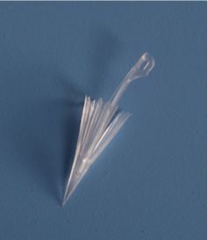
PolyCorTM - Anchor Engineered for Cardiac Fixation
Anchor platform engineered for catheter-based percutaneous fixation
  Compliant anchors “conform” to beating heart
  Retracting barbs facilitate tissue penetration and anchor placement
  Expanding barbs resist pull out up to a 4N load
  Biocompatibile
  Polypropylene used in millions of implants
Ultra low mass implant
  Complies with natural cardiac function
Clinically Validated
  Over 45 patients
  No Clinical Adverse Events
Investigational Device ONLY.

Slide 4
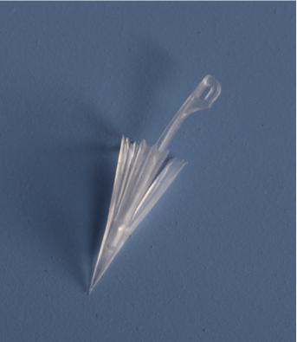
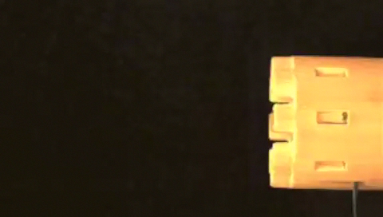
High Speed, Delivery Systems
High Speed Delivery Systems:
Implant Deployed in 0.002 seconds
MIA Implant Pre/Clinical Safety and Performance Data
Investigational Device ONLY.

Slide 5
PolyCor - Anchor Engineered for Cardiac Fixation
Current Anchor
Enhanced Anchor
14.74 mm
10.24 mm

Slide 6
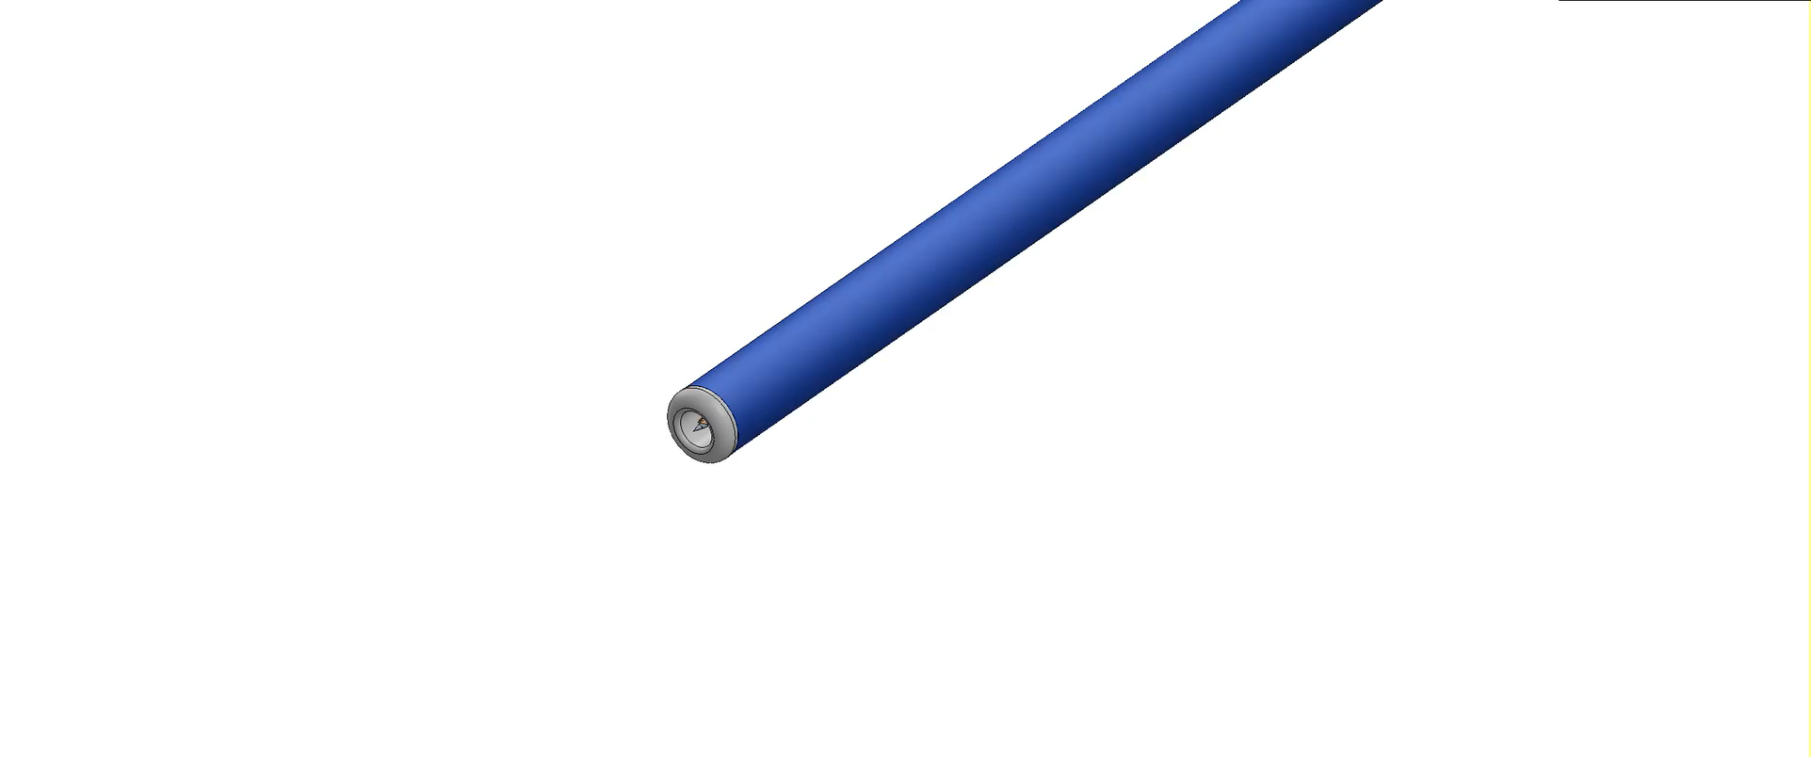
MIA - Simple, Safe and Secure Technology
Applying minimally invasive surgical and interventional knowledge to achieve surgical efficacy with percutaneous safety.
Investigational Device ONLY.

Slide 7
MIA Tricuspid System, Implant and Stabilizing Unit
Steerable Guiding Sheath
Stabilization Unit
Delivery Catheter
Implant
Representative 3D Echo of implant locations between AP and PS commissures (area of annular dilatation)
Investigational Device ONLY.
Confidential – For Internal Use Only

Slide 8
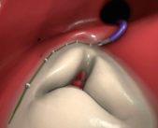
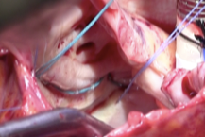
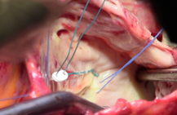
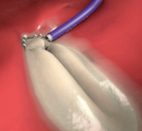
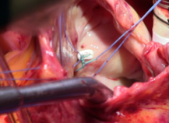
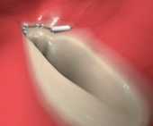
Technology Replicates Surgical Procedures
Standard Surgical Bicuspidization
MIA Replicates Clinical Surgical Technique
Percutaneous Tricuspid MIA Procedure
Investigational Device ONLY.
Photos courtesy of Professor Kestutis Rucinskas, MD, Chief of Cardiac Surgery
Vilnius University Hospital Santariskiu Clinics
Confidential – For Internal Use Only

Slide 9
STTAR Feasibility Arm - Surgical Results
Results at 12 Month Follow Up
45% Reduction in annular area
Investigational Device ONLY.

Slide 10
STTAR: Study of Transcatheter Tricsupid Annular Repair
60 Patient; 6 Center CE Mark Study
  Vilnius University Hospital, Santaros Klinikos, Vilnius, Lithuania
  Kaunas University Hospital, Kaunas, Lithuania
  Semmelweis University, Budapest, Hungary
  Cardinal Wyszynski National Institute of Cardiology, Warsaw, Poland
  Pauls Stradins Clinical University Hospital, Riga, Latvia
  Pending - Aarhus University Hospital Denmark, Aarhus, Denmark
Image- Guided Percutaneous Arm
  Pre procedure CT and Echo
  Fluoroscopy, 2D and 3D Echocardiography
End Points:
  Safety:
    Major Adverse Events
  Performance:
    Technical Success Rate
    Reduction in Tricuspid Regurgitation/EROA
    Six Minute Walk Test
    QOL
FIH Vilnius, Lithuania (October 2018)
Investigational Device ONLY.

Slide 11
STTAR: Study of Transcatheter Tricsupid Annular Repair
Study Design: Prospective non-randomized safety and performance study
Patient Criteria n = 10
Inclusion Criteria:
  Age ≥18
  New York Heart Association (NYHA) Class II-IV
  Left ventricular ejection fraction (LVEF) ≥30%
  Tricuspid valve annular diameter ≥ 40 mm (or 21 mm/m2) 3-4 + FTR
Exclusion Criteria:
  Previous tricuspid valve repair or replacement
  Life expectancy of less than 12-months
  Pulmonary hypertension with PA mean 2/3 rd MAP
  Severe right heart dysfunction
Variables | Mean (Range)
Age, years | 74(61-85)
Euroscore II | 4.75(1-14.2)
Gender,female | 7(58%)
NYHA II | 2(20%)
NYHA III | 7(70%)
NYHA IV | 3(30%)
Atrial fibrillation | 6(50%)
Pulmonary hypertension | 6(50%)
Pacemaker | 3(30%)
Investigational Device ONLY.
Investigational Device ONLY

Slide 12
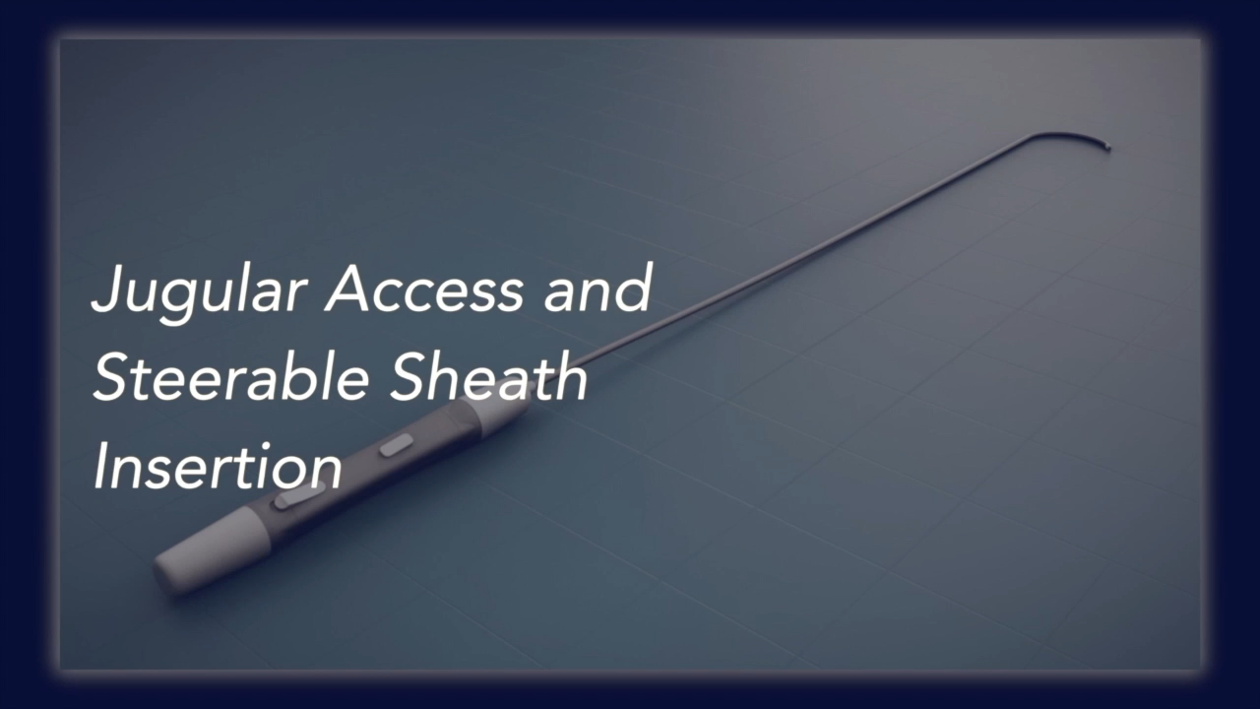
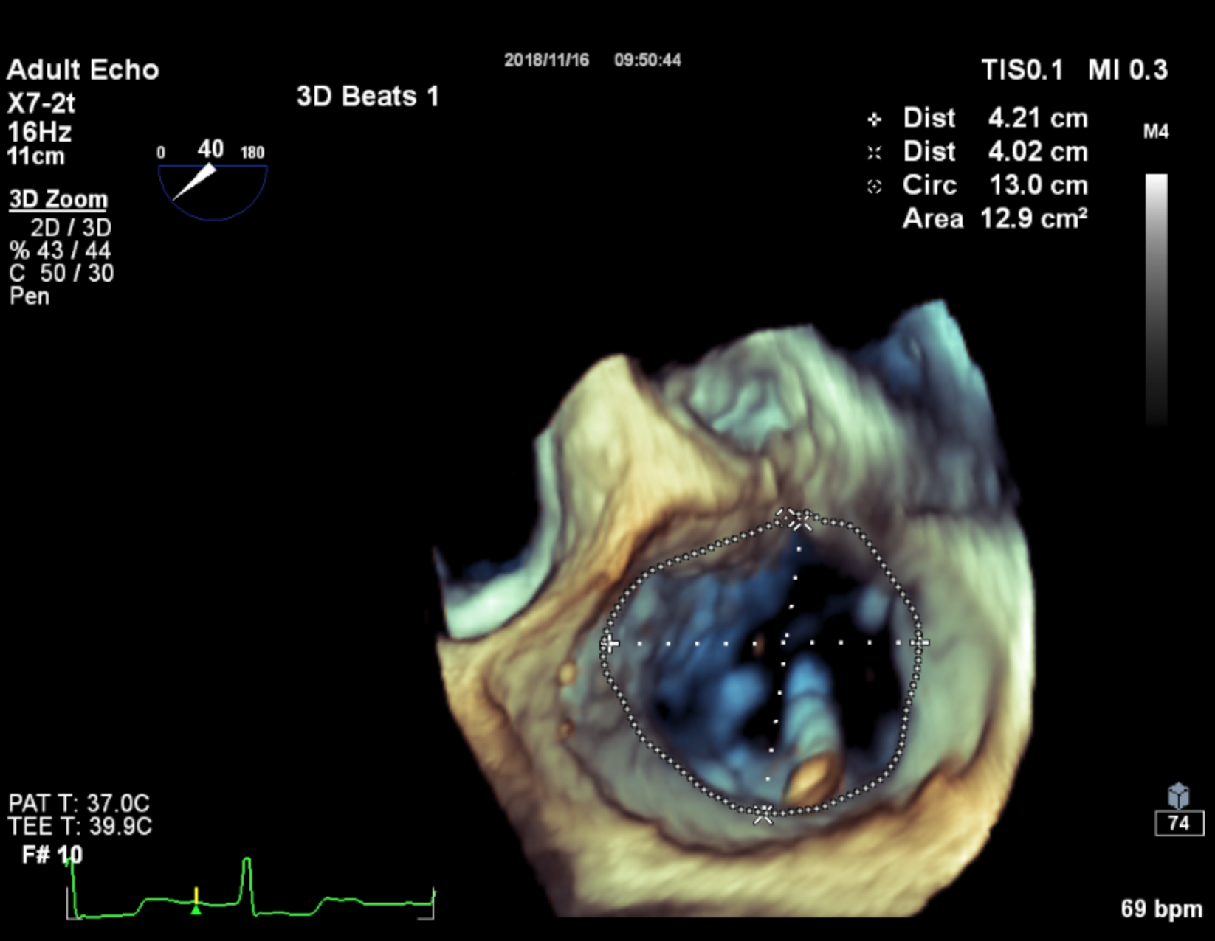
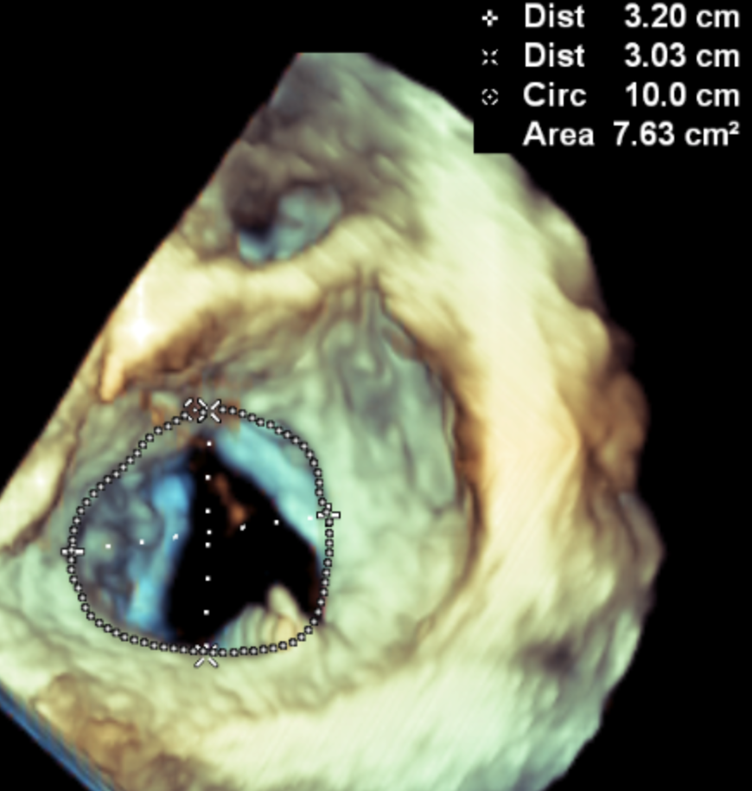
STTAR: Study of Transcatheter Tricsupid Annular Repair
FIH Transcatheter Procedure
Video courtesy of Professor Kestutis Rucinskas, MD, Chief of Cardiac Surgery; Vilnius University Hospital Santariskiu Clinics
Fluoroscopy Pre-Plication – Annular Area 14.2cm²
Fluoroscopy Post-Plication – Annular Area 7.6cm²
Notes:
We used trans-jugular approach to reach right atrium with steerable guiding sheeth. Further delivery catheter insertion and navigation with TEE. After identification of antero-posterior commissure we stabilize delivery system by deploying stabilization pins which also help us navigate close to right coronary artery and ensure we do not deploy into unnecesary anatomical structures. Anchors deployed into the posterior portion of the annulus. Then we plicate the tissue by approximating the anchors and securing the bicuspidization with a suture lock.

Slide 13
STTAR: Percutaneous Results
STTAR: Study of Transcatheter Tricsupid Annular Repair
Investigational Device ONLY
Pre Plication
Post Plication
*
Acute results n = 10 (p = 0.0001)
3 Month Follow Up n = 4 (p = 0.007)
33%
26.4%
26.4%
*Mann-Whitney U test
Investigational Device ONLY.

Slide 14
STTAR: Study of Transcatheter Tricsupid Annular Repair
STTAR Clinical Case – Budapest, Hungary
52% Reduction in Annular Area
Radiopaque anchors on echo
Pre Plication on Fluoroscopy – 14.5 cm²
Post Plication on Fluoroscopy – 6.94 cm²
Investigational Device ONLY.
  Photos courtesy of the Semmelweis University, Budapest, Hungary

Slide 15
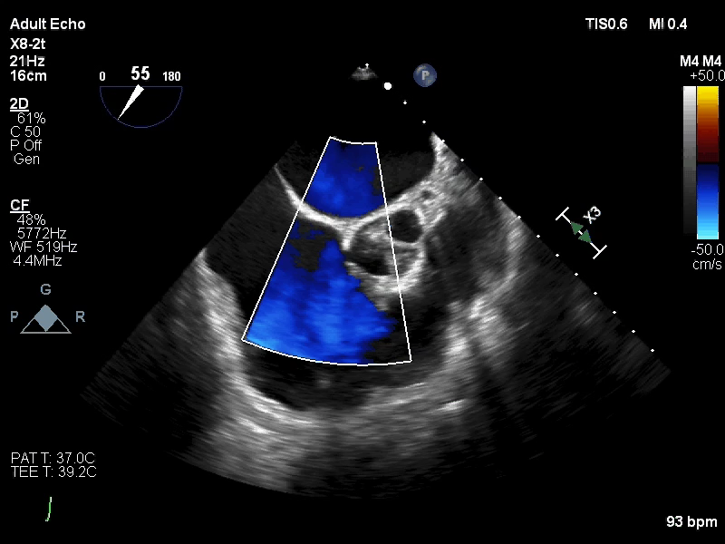
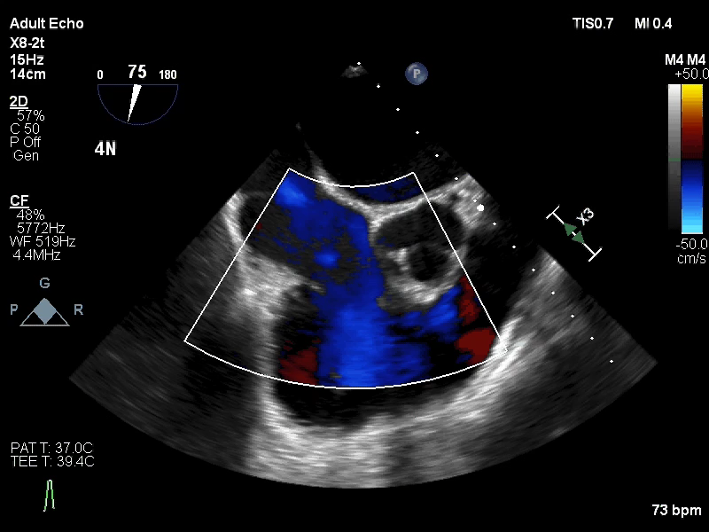
STTAR: Study of Transcatheter Tricsupid Annular Repair
Severe TR to Trace TR
STTAR Clinical Case – Budapest, Hungary
Color Doppler Prior to MIA Plication
Color Doppler Post MIA Plication
  Images courtesy of the Semmelweis University, Budapest, Hungary
Investigational Device ONLY.

Slide 16
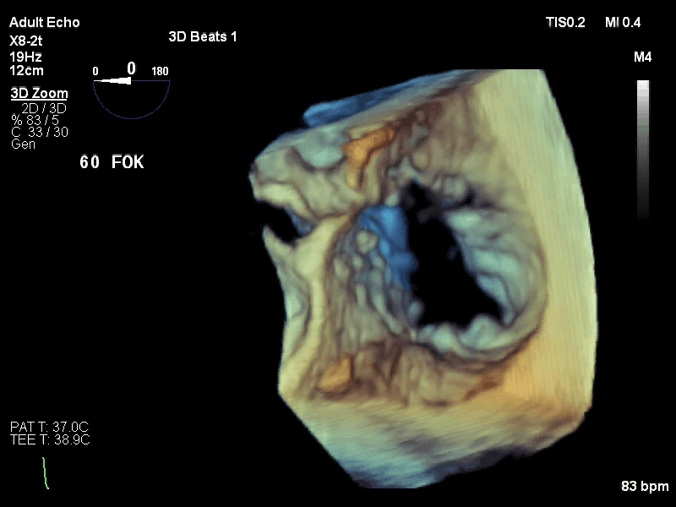
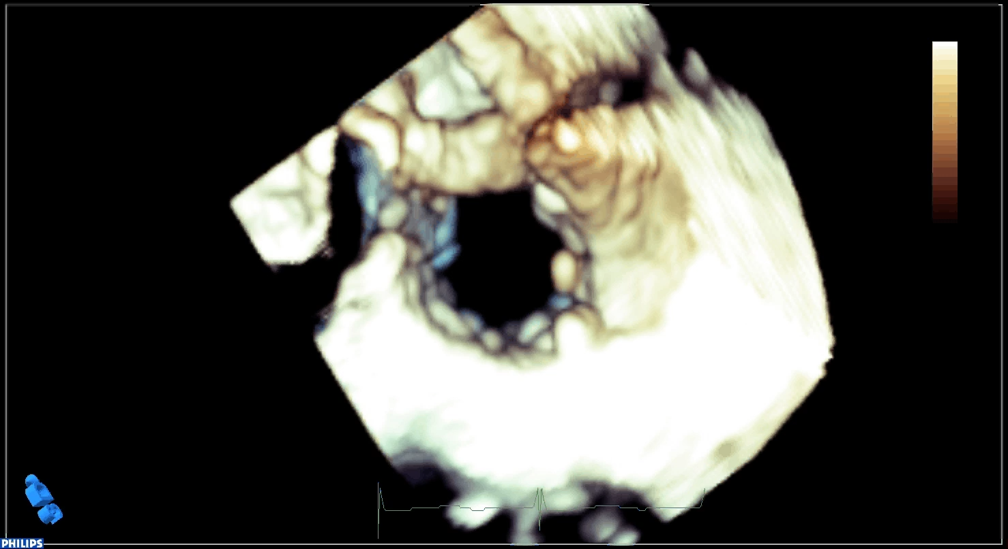
STTAR: Study of Transcatheter Tricsupid Annular Repair
STTAR Clinical Case – Budapest, Hungary
3D Echo Prior to MIA Plication
3D Echo Post MIA Plication
  Images courtesy of the Semmelweis University, Budapest, Hungary
Investigational Device ONLY.

Slide 17
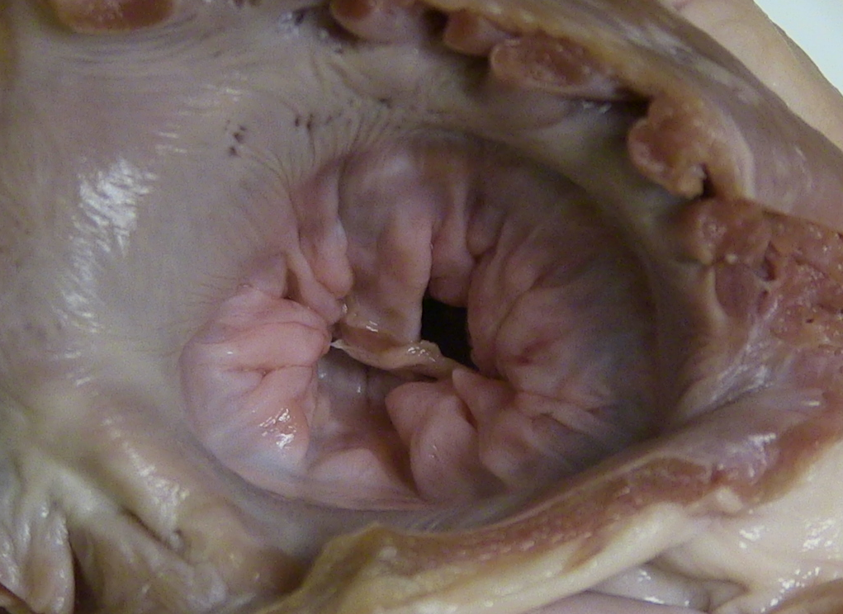
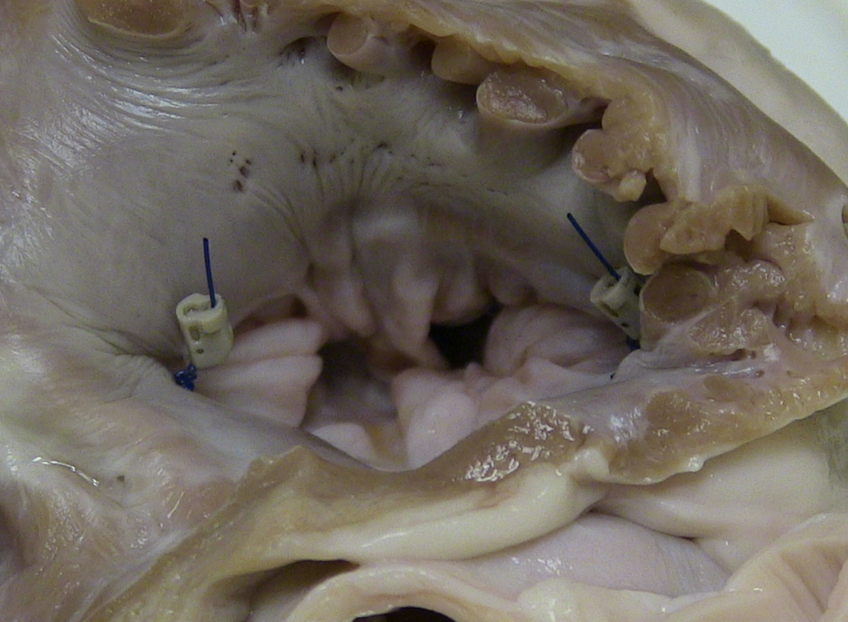
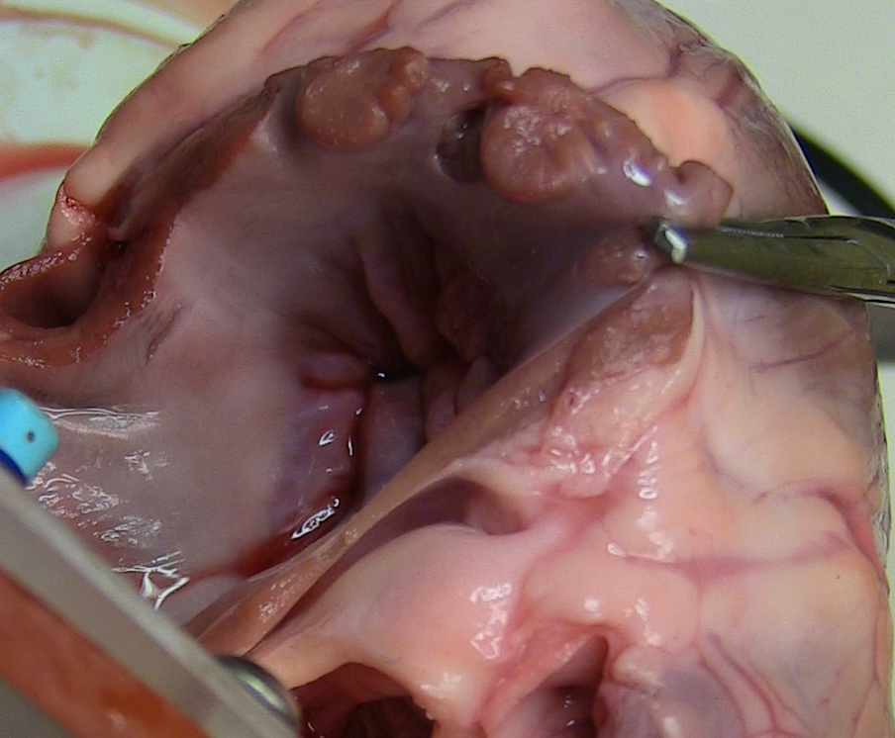
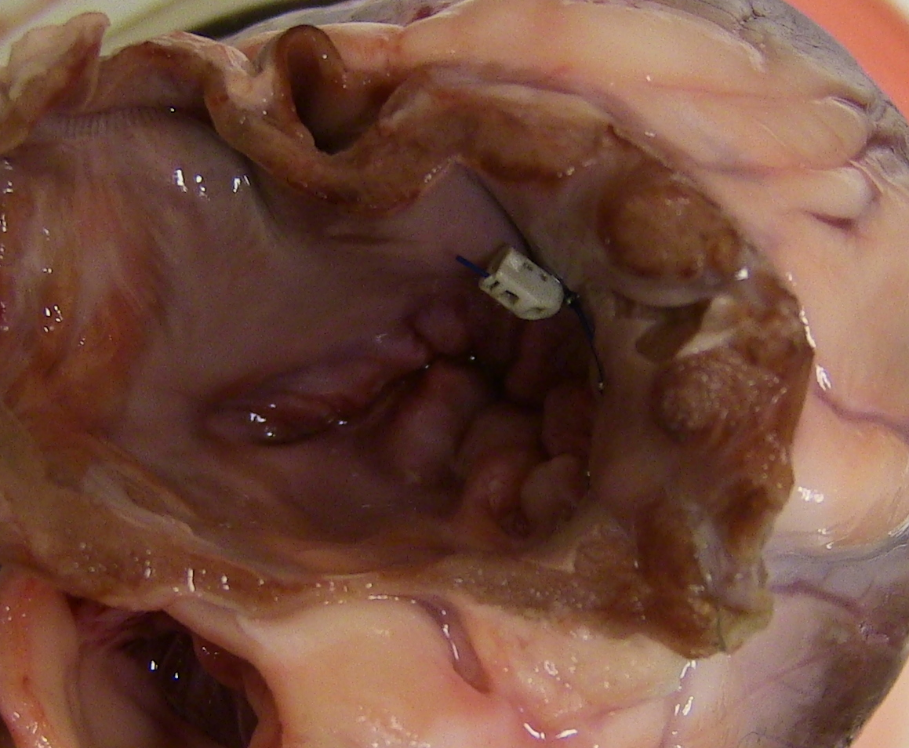
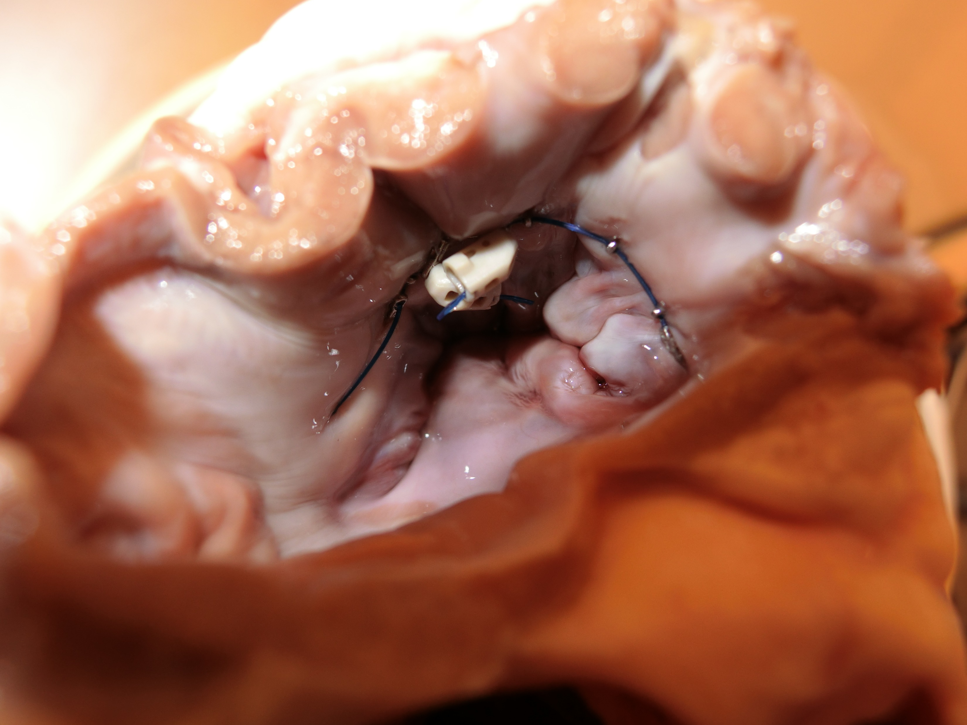
MIA –Mitral Repair Program Working Towards FIH
Preclinical results of a Kay Procedure Annuloplasty
Mitral Valve before Implantation
Mitral Valve after second plication
Preclinical results of a Continuous Ring Annuloplasty
Annulus Pre-procedure
Array 1 Locked
Arrays 1 & 2 Locked
Investigational Device ONLY.

Slide 18
A simple, safe and secure transcatheter repair technology
  A 60 patient STTAR CE Mark study is ongoing in Europe
  Safety profile is high – no serious device-related adverse events peri-procedurally or during follow-up
  Significant and durable reductions in tricuspid regurgitation and annular dimensions have been achieved
  Technology treats a wide range of functional TR patients with minimal exclusion criteria
  Procedure is simple and the learning curve appears to be short, with procedure times as low as 70 minutes in early transcatheter experience
Replicates surgical procedures on the end of a catheter
Investigational Device ONLY.

